Slide 1

Construction Robotics WS 2022/23 final presentation, February 6, 2023
Group 1 : Moayed Elmoursi, Rami Nasr, Abdelrahman Abounida, Utku Elagoz, Ararat Cetinkaya
Robust Fiducial Markers Detection And Following Using Quadruped Robot
Institute of Digital and Autonomous Construction
Hamburg University of Technology
Blohmstraße 15
21079 Hamburg

Slide 2
Agenda
Problem Formulation
Proposed Solution
Camera Calibration
April Tag Detection
Control
Simulation Results and ROS
Experimental Results
Future Works
ss
Group1 - Robust Fiducial Markers Detection And Following Using Quadruped Robot
Construction Robotics WS 2022/23 final presentation, February 6, 2023

Slide 3


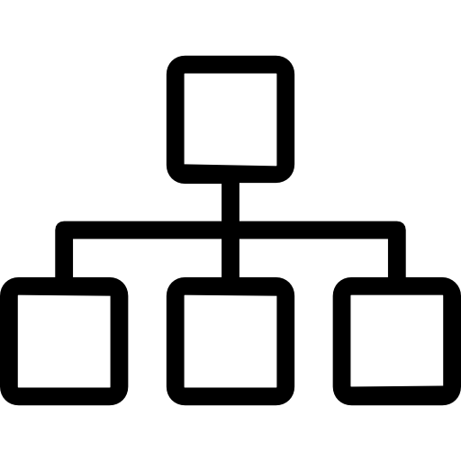


Problem Analysis
Mldog-Control
Results
AprilTag Detection
Simulation & ROS
ss
Group1 - Robust Fiducial Markers Detection And Following Using Quadruped Robot
Construction Robotics WS 2022/23 final presentation, February 6, 2023

Slide 4
Problem Formulation
Why AprilTag?
    Many real-world applications
      Agriculture
      Industrial automation
      Environmental monitoring
  Robust
    Detection error rates
    Highly scalable
Navigation is one of the most challenging competencies required for mobile robots.
Existing navigation approaches use high-level sensors which are cost-demanding, such as:
  GPS
  high-level cameras.
ss
Group1 - Robust Fiducial Markers Detection And Following Using Quadruped Robot
Construction Robotics WS 2022/23 final presentation, February 6, 2023

Slide 5
Challenges
Tracking
Latency
Robustness
Interoperability
Calibration
ss
Group1 - Robust Fiducial Markers Detection And Following Using Quadruped Robot
Construction Robotics WS 2022/23 final presentation, February 6, 2023

Slide 6
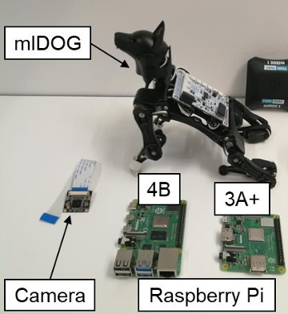
Proposed Solution
Low-cost cameras and robots is used.
Raspberry Pi 3A Microprocessor
Raspberry Pi Camera
Petoi Dog Open Source Programmable Quadruped Robot
NyBoard V1
Construction Robotics Seminar 2: Hardware and Prof. Dr. softwareIng. Kay specific Smarsly , basicsJan Stührenberg, M.Sc. Lecture’s slides
ss
Group1 - Robust Fiducial Markers Detection And Following Using Quadruped Robot
Construction Robotics WS 2022/23 final presentation, February 6, 2023

Slide 7


Problem Analysis
Mldog-Control
Results
AprilTag Detection
Simulation & ROS
ss
Group1 - Robust Fiducial Markers Detection And Following Using Quadruped Robot
Construction Robotics WS 2022/23 final presentation, February 6, 2023

Slide 8
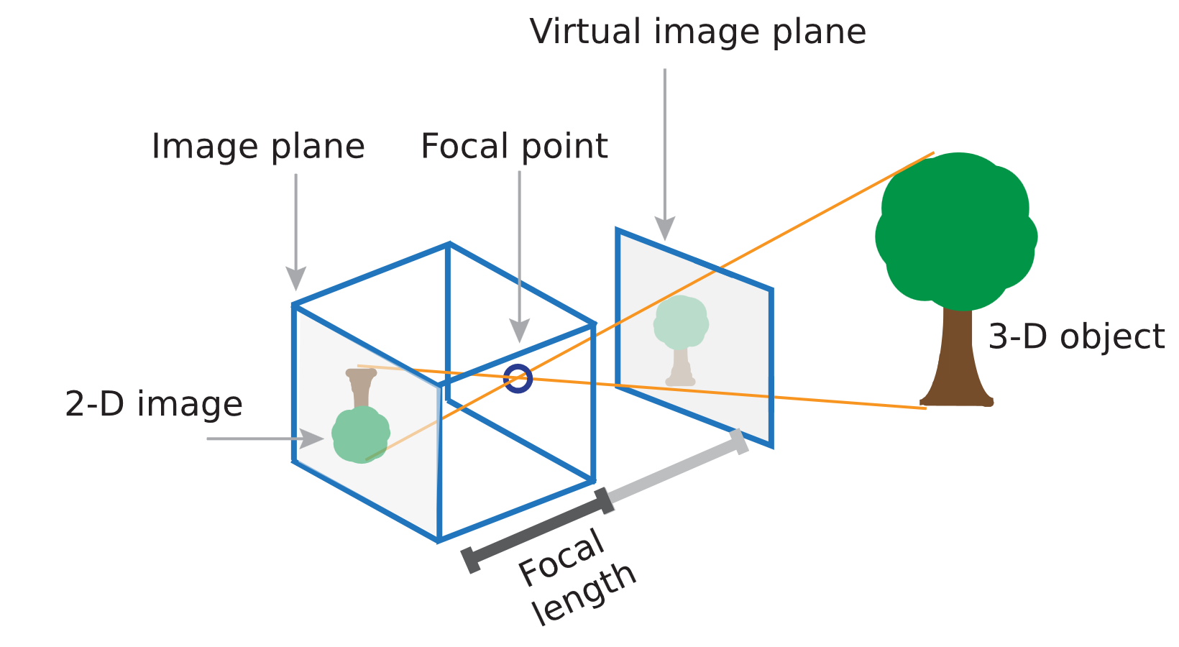
Camera Calibration
The importance of camera calibration
Coreccting lens distortion.
Finding the intrinsic and extrinsic parameters.
Matching image coordinate to real world coordinates.
Group1 - Robust Fiducial Markers Detection And Following Using Quadruped Robot
Construction Robotics WS 2022/23 final presentation, February 6, 2023

Slide 9
Camera Calibration
Chessboard Calibration Method
Recognizable points even it is distorded.
Easy to create.
Finding corners of the checkerboard with “findChessboardCorners’’ function.
Finding calibration matrix with “calibrateCamera’’.
ss
Group1 - Robust Fiducial Markers Detection And Following Using Quadruped Robot
Construction Robotics WS 2022/23 final presentation, February 6, 2023

Slide 10
AprilTag Detection
First step is detecting the AprilTags with an external camera.
An artificial environment for AprilTag Detection is created to test the algorithms before using the real robot.
Apriltag library from Swatbotics and AprilRobotics are used and the AprilRobotics library is decided.
The detection algorithm and the CNN model are first tested with the webcam, then they are implemented on the MIDog for real world testing.
ss
Group1 - Robust Fiducial Markers Detection And Following Using Quadruped Robot
Construction Robotics WS 2022/23 final presentation, February 6, 2023

Slide 11


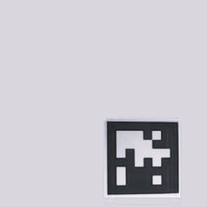
MIDog Moving Algorithm
A two level continuous moving algorithm with pose detection is implemented to follow the AprilTag.
After detecting the pose of the AprilTag, the translation vector is used to obtain the distance between the Dog and the AprilTag, also the position of the AprilTag in the horizontal axis.
First level is checking the distance between the Dog and AprilTag
Second level is deciding on whether to move right, left or straight.
ss
Group1 - Robust Fiducial Markers Detection And Following Using Quadruped Robot
Construction Robotics WS 2022/23 final presentation, February 6, 2023

Slide 12
AprilTag Detection CNN Model
After the try-outs with external cameras and the MIDog, it has been decided that a more robust approach is needed.
Creating the Dataset
1. 2200+ new images are created for training
2. 400+ new images for testing
Training the Model
1. Accuracy with small size is aimed.
2. Mean Square Error and Adam optimizer is used.
Testing and Implementing the Model
1. 10% Error by pixel
2. Supporting the moving algorithm
ss
Group1 - Robust Fiducial Markers Detection And Following Using Quadruped Robot
Construction Robotics WS 2022/23 final presentation, February 6, 2023

Slide 13
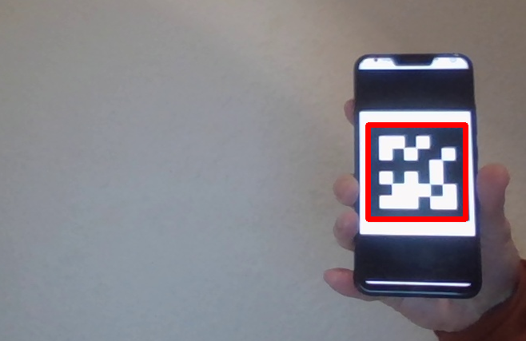
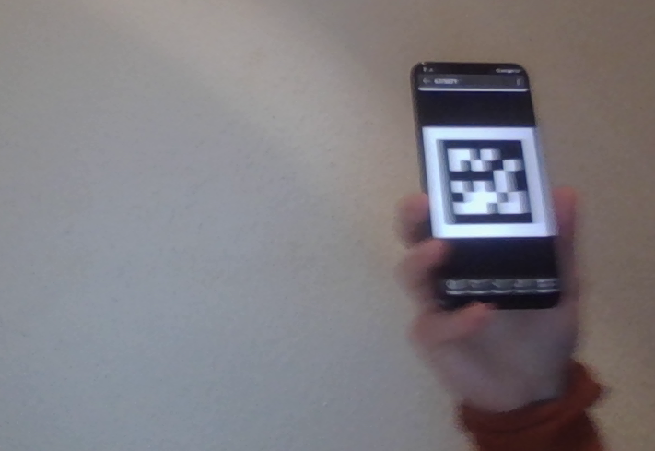
Detection Examples
Detection with Apriltag.detect function
Detection with CNN
ss
Group1 - Robust Fiducial Markers Detection And Following Using Quadruped Robot
Construction Robotics WS 2022/23 final presentation, February 6, 2023

Slide 14
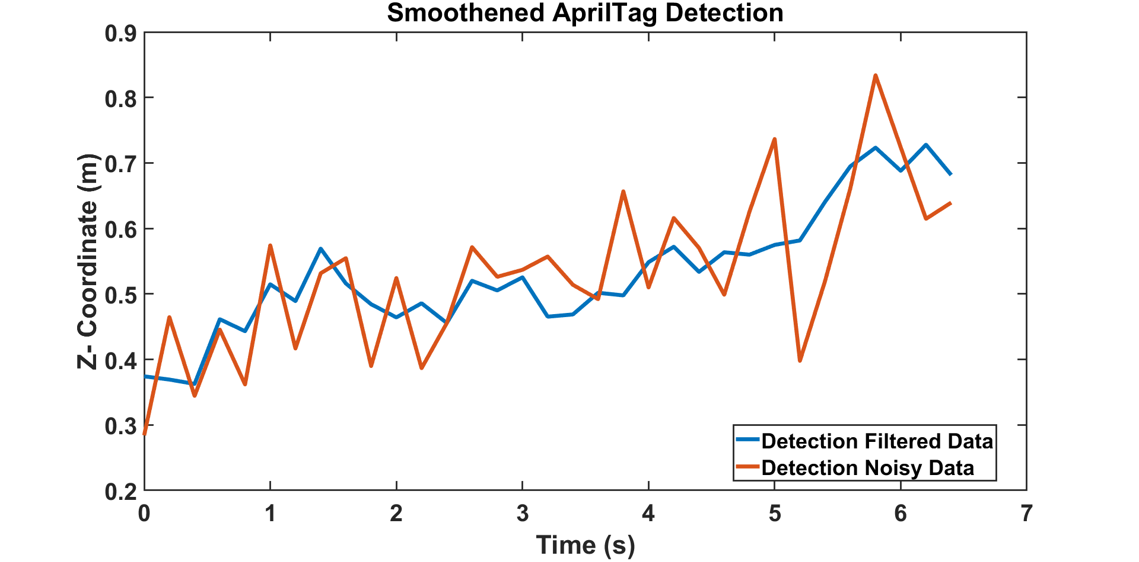
Filtering
Since the readings from the AprilTag are quite noisy filtering is required.
The readings are further filtered using a moving average filter at constant time steps to smoothen these readings and improve the measurements.
ss
Group1 - Robust Fiducial Markers Detection And Following Using Quadruped Robot
Construction Robotics WS 2022/23 final presentation, February 6, 2023

Slide 15



Mldog-Control
Results
Problem Analysis
AprilTag Detection
Simulation & ROS
ss
Group1 - Robust Fiducial Markers Detection And Following Using Quadruped Robot
Construction Robotics WS 2022/23 final presentation, February 6, 2023

Slide 16
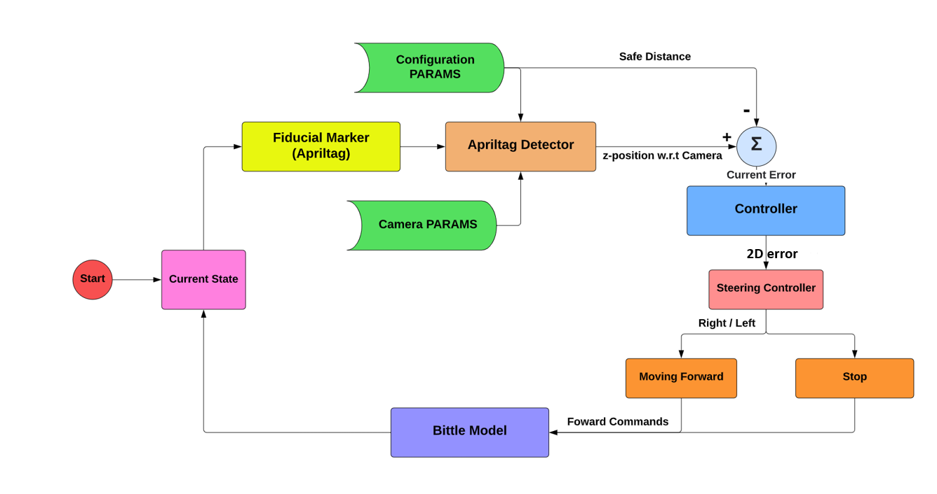
Control
A simple proportional controller was used.
An error in the X direction would activate the steering controller in the Z direction would determine the forward movement.
ss
Group1 - Robust Fiducial Markers Detection And Following Using Quadruped Robot
Construction Robotics WS 2022/23 final presentation, February 6, 2023

Slide 17


Problem Analysis
Mldog-Control
Results
AprilTag Detection
Simulation &ROS
ss
Group1 - Robust Fiducial Markers Detection And Following Using Quadruped Robot
Construction Robotics WS 2022/23 final presentation, February 6, 2023

Slide 18


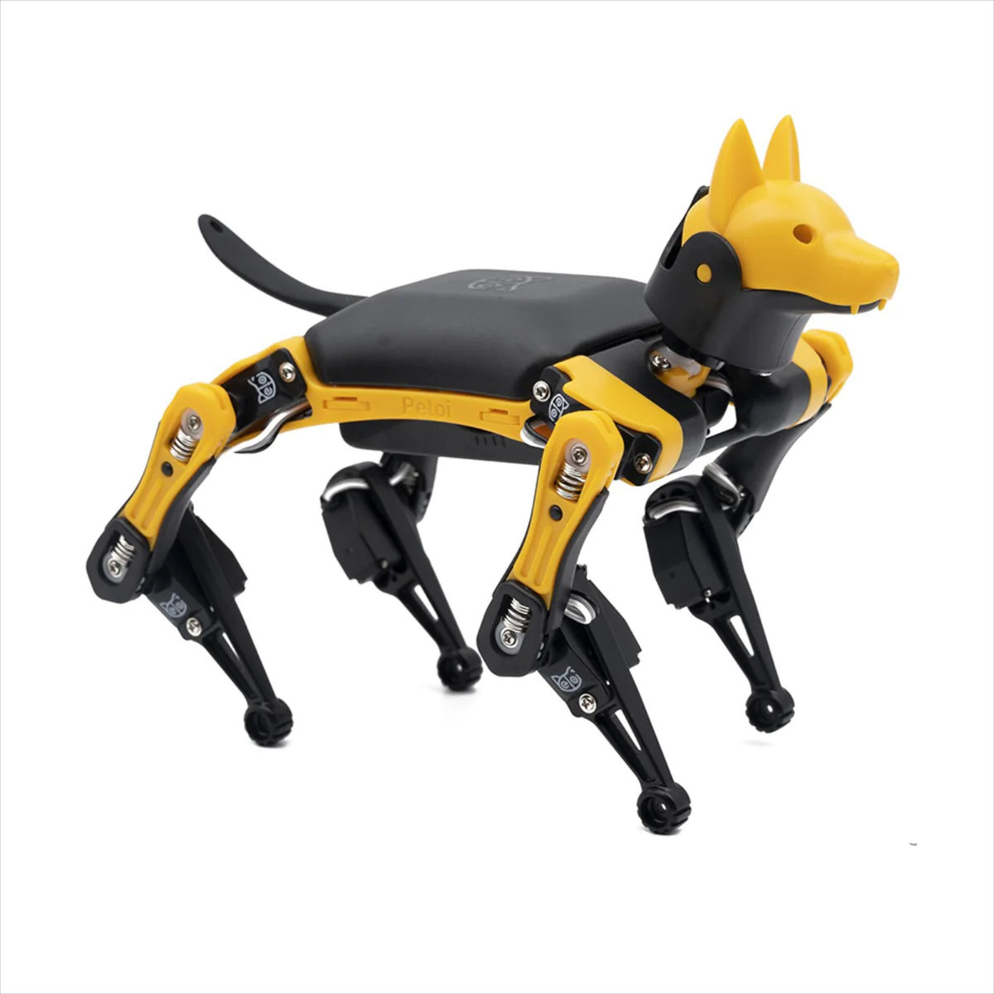
Workflow
Camera Calibration
Pose
Estimation
Controller
Current State
ss
Group1 - Robust Fiducial Markers Detection And Following Using Quadruped Robot
Construction Robotics WS 2022/23 final presentation, February 6, 2023
Controller
8

Slide 19
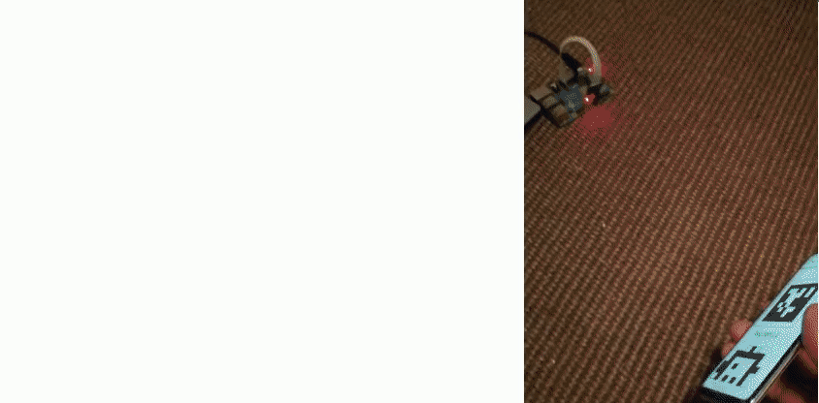
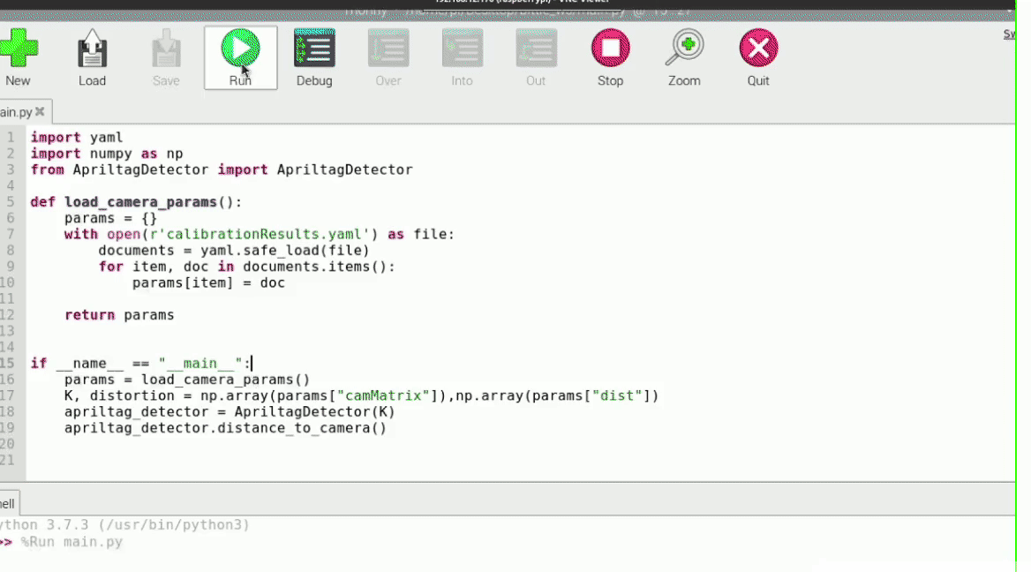
Why Simulation ?
ss
Group1 - Robust Fiducial Markers Detection And Following Using Quadruped Robot
Construction Robotics WS 2022/23 final presentation, February 6, 2023

Slide 20
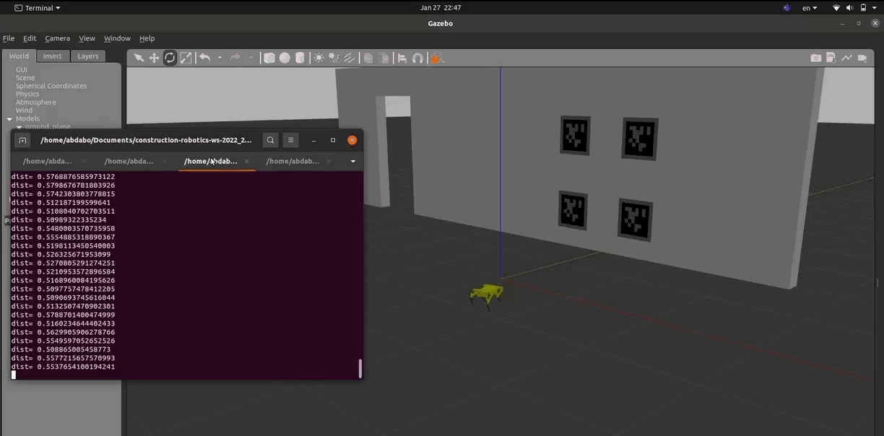
Gazebo Simulation
ss
Group1 - Robust Fiducial Markers Detection And Following Using Quadruped Robot
Construction Robotics WS 2022/23 final presentation, February 6, 2023

Slide 21
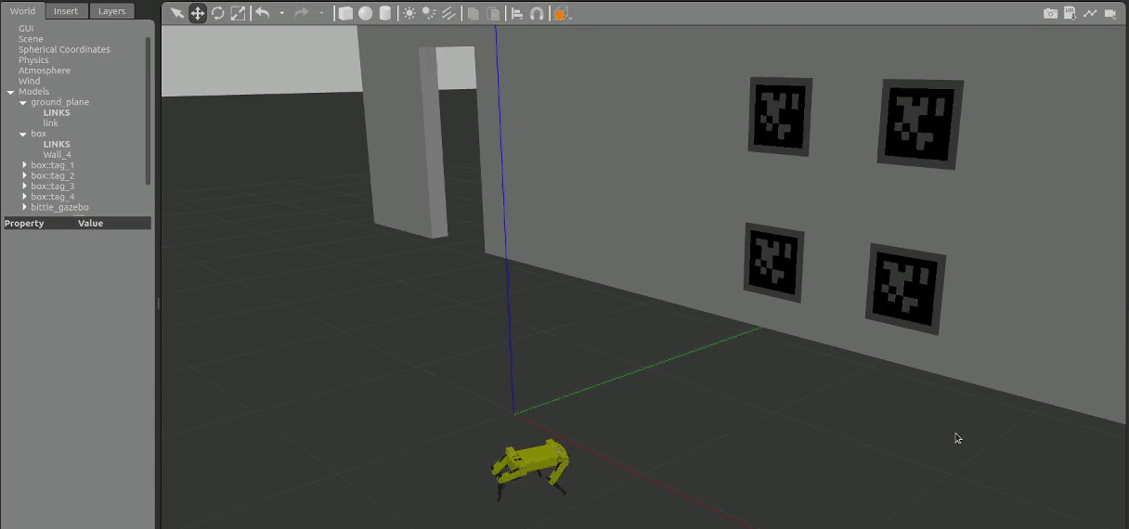
Gazebo Simulation - updated
ss
Group1 - Robust Fiducial Markers Detection And Following Using Quadruped Robot
Construction Robotics WS 2022/23 final presentation, February 6, 2023

Slide 22
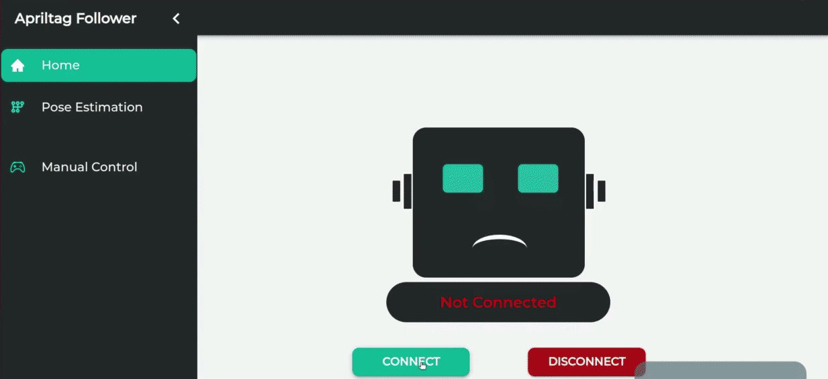
Web UI - React Dashboard
ss
Group1 - Robust Fiducial Markers Detection And Following Using Quadruped Robot
Construction Robotics WS 2022/23 final presentation, February 6, 2023

Slide 23
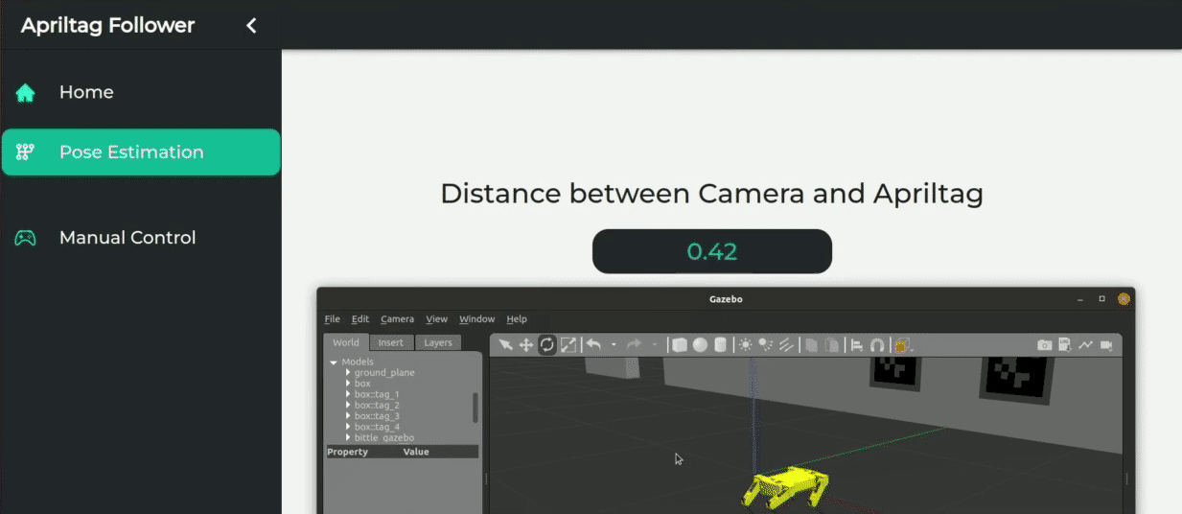
Web UI - React Dashboard
ss
Group1 - Robust Fiducial Markers Detection And Following Using Quadruped Robot
Construction Robotics WS 2022/23 final presentation, February 6, 2023

Slide 24


Mldog-Control
Results
Problem Analysis
AprilTag Detection
Simulation & ROS
ss
Group1 - Robust Fiducial Markers Detection And Following Using Quadruped Robot
Construction Robotics WS 2022/23 final presentation, February 6, 2023

Slide 25
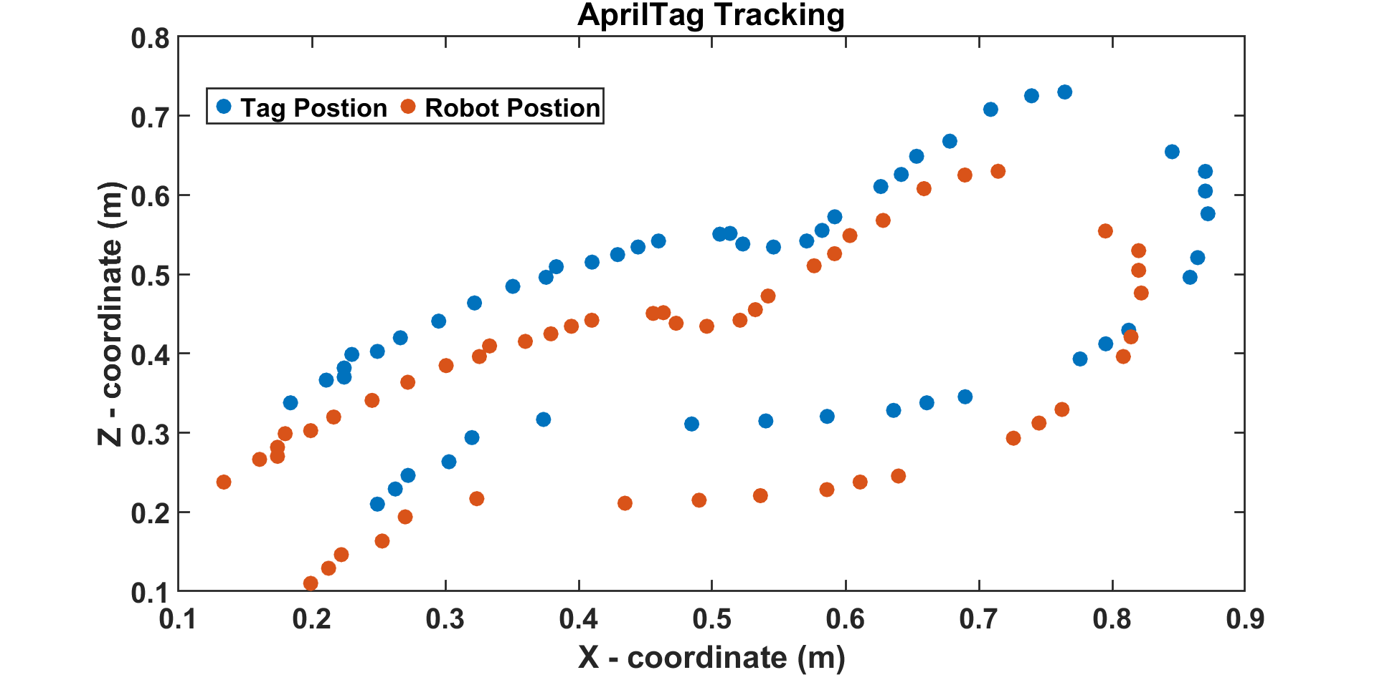
Experimental Tracking Results
Following a dynamic moving tag using the previously explained controller was successful.
Tracking the tag was accurate with the safe distance between the robot and the tag maintained
ss
Group1 - Robust Fiducial Markers Detection And Following Using Quadruped Robot
Construction Robotics WS 2022/23 final presentation, February 6, 2023

Slide 26

Q & A

Slide 27
Bibliography
ss
Group1 - Robust Fiducial Markers Detection And Following Using Quadruped Robot
Construction Robotics WS 2022/23 final presentation, February 6, 2023

